Slide 1
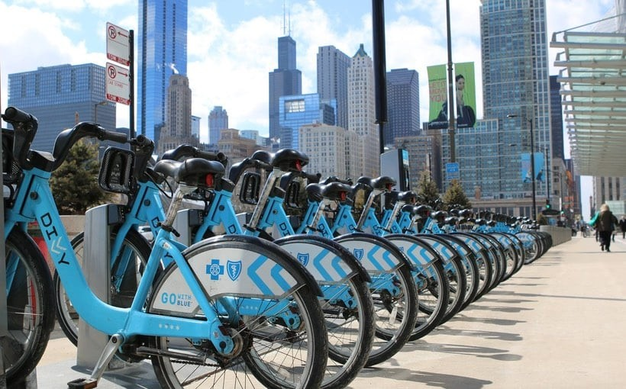
Cyclistic Bike-Share Analysis: Converting Casual Riders to Annual Members
Identifying Usage Patterns to Drive Growth
Emmanuel Aryeetey
2025-12-30

Slide 2
The business task
Objective
Understand how annual members and casual riders use Cyclistic bikes differently to design a membership conversion marketing strategy.
Key Question
What are the distinct behavioral differences between "Casual" riders and "Annual Members"?

Slide 3
Data overview and methodology
Data Source: Historical trip data from the first quarter of 2019 and 2020 provided by Motivate International Inc.
Tools Used: R (tidyverse, lubridate, janitor) for data cleaning, manipulation, and visualization.
Data Integrity: Cleaned ID columns, handled date/time formats, and normalized trip durations for accuracy.

Slide 4
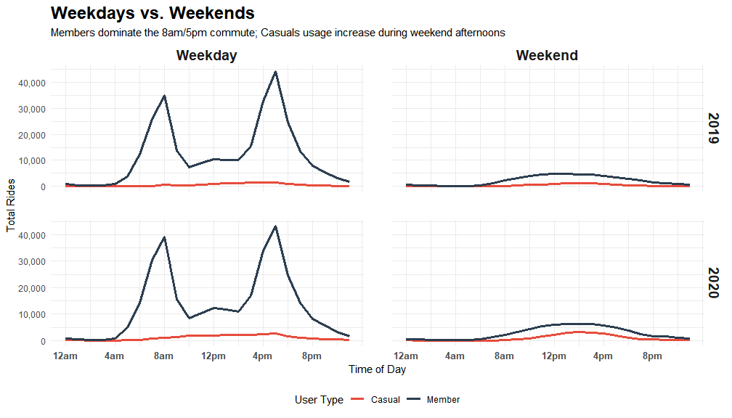
Notes:
Insight: Members are the "backbone" of the system, showing high, steady volume Monday through Friday. Casual ridership is low during the workweek, but increases on Saturday and Sunday.
Demand throughout the day: Highlight that member peaks coincide with traditional rush hours, while casual demand builds steadily in the afternoon.

Slide 5
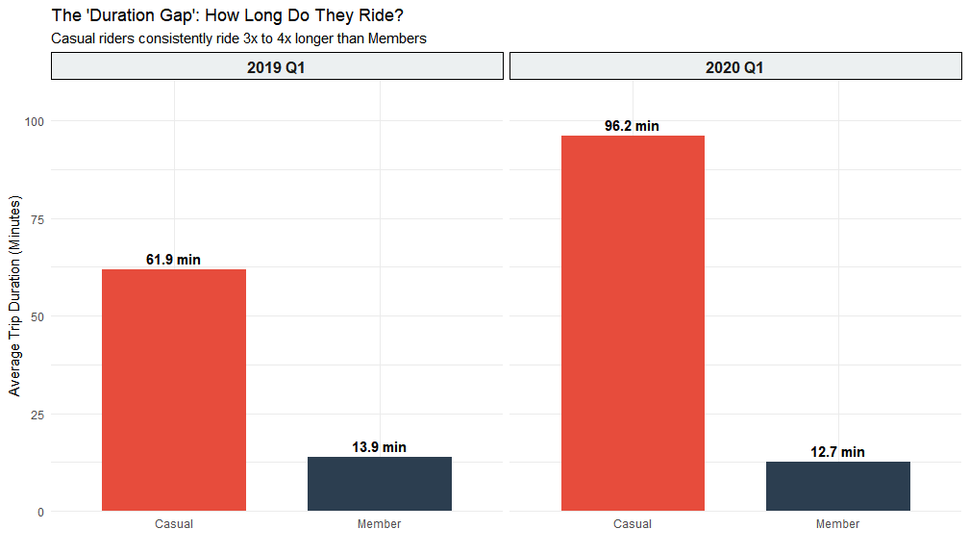
Notes:
Data Point: Casual riders take significantly longer trips (averaging over 3,000 seconds) compared to members (under 1,000 seconds).
Analysis: Members prioritize "Point A to Point B" efficiency. Casual riders use the bike as the activity itself, stopping for photos or taking scenic routes.

Slide 6
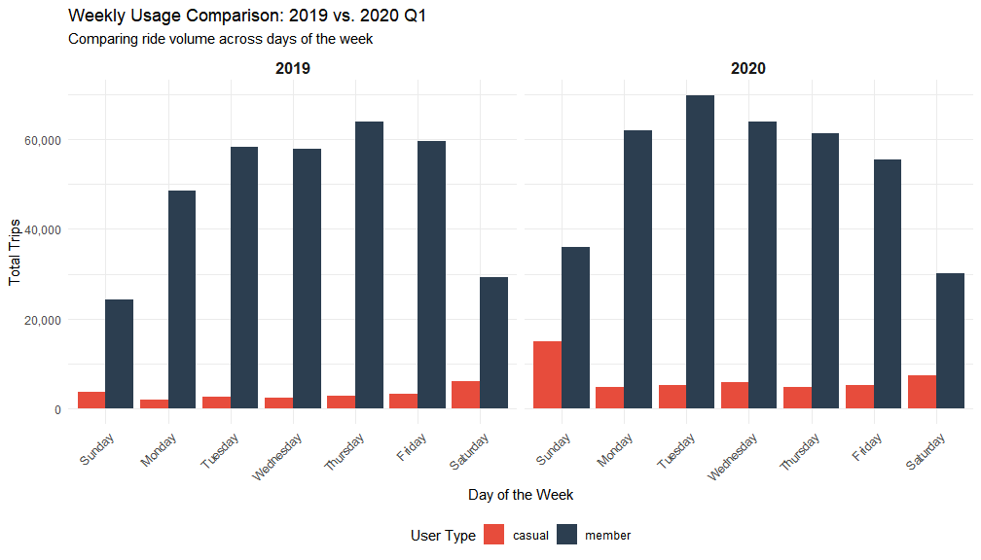
Notes:
Insight: Annual members have a very steady usage pattern from Monday to Friday, suggesting a commuter-based behavior.
Conversely, Casual ridership spikes on Saturday and Sunday, confirming that their usage is primarily recreational.

Slide 7
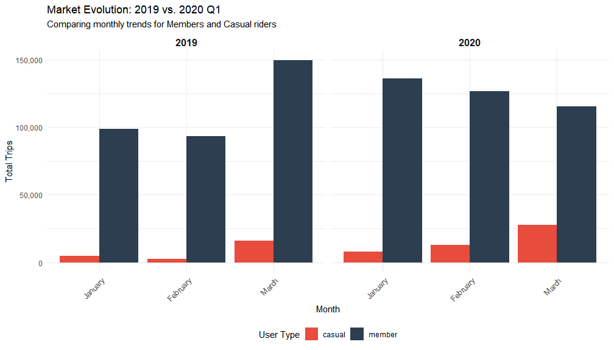
Notes:
Insight: While both groups peak in summer, casual ridership almost disappears in winter.
Insight: Members continue to ride even in colder months, proving they rely on Cyclistic as an essential transit link.

Slide 8
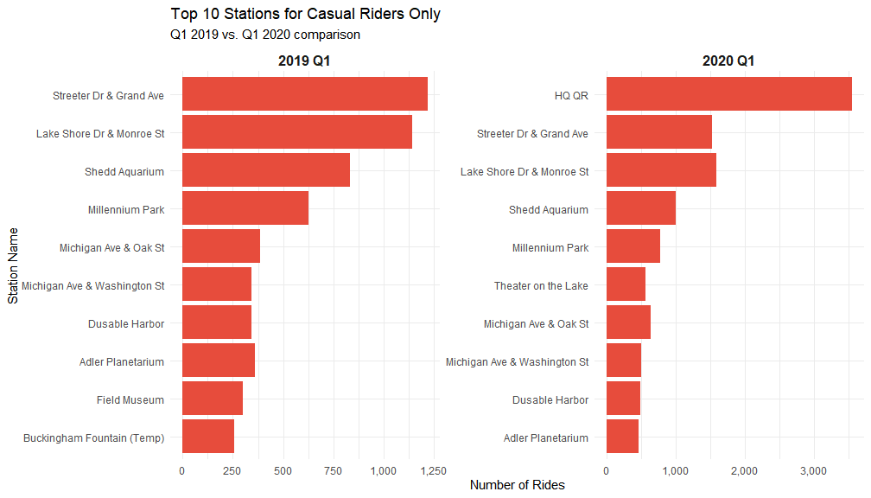

Slide 9
Business conclusion
Annual members maintain high, consistent ride volumes from Monday through Friday for routine commuting, while casual ridership is significantly lower during the weekdays and increases on weekends.
Casual riders take much longer trips compared to members.
Ride volume for both groups starts very low in mid-winter but begins a steep upward climb as March approaches
Casual riders heavily concentrate their activity at lakefront and tourist-centric stations like Streeter Dr & Grand Ave, rather than inland transit hubs.

Slide 10
Recommendations
Launch conversion campaigns at top casual-rider stations like Streeter Dr & Grand Ave during the transition into spring.
Introduce a specialized membership tier for weekends to capture the high-volume recreational users.
Use mid-week digital advertisements to highlight the efficiency of the service for daily routines.
Create marketing content that emphasizes how annual memberships provide better cost-efficiency for the long-duration exploratory trips.

